Slide 1


Bright Coffee Shop: Sales & Business Performance Analysis

Slide 2


Business
Objective
The purpose of this analysis is to identify sales trends, high-performing products, profitable product categories, store performance and peak trading periods in order to support data-driven business decisions.

Slide 3

Key areas investigated
Revenue performance
Product performance
Product category performance
Store performance
Sales by day
Sales by time of day
Monthly sales trends
Sales growth
Quantity sold

Slide 4
Executive Summary
KPI | Result
Total Revenue | $698,812.33
Transactions | 149,116
Items Sold | 214,470
Stores | 3
Products | 80
Average Transaction Value | $4.69
Analysis Period | Jan–Jun 2023

Slide 5
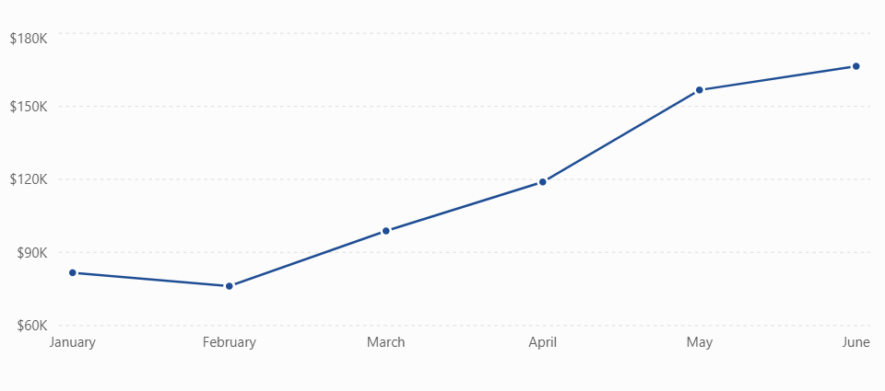
Monthly Revenue Trend

Slide 6

Revenue model
Gourmet coffee beans
Signature coffee beverages
Pastries & Food Pairings

Slide 7



Gourmet coffee beans
Pastries & Light Bites
Sale of premium, ethically-sourced BrightCoffee beans in-store for home brewing, targeting coffee enthusiasts who want cafe quality at home.
Freshly baked pastries paired with coffee to increase average basket size and attract morning and lunch traffic.
Signature coffee beverages
High-margin, handcrafted drinks like our Latte and Cappuccino, served in-store as our core daily revenue driver.

Slide 8
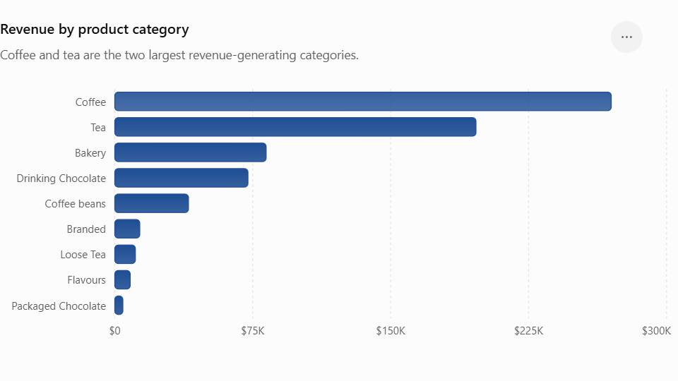
Product Category Performance

Slide 9
Sales by Time of Day
Time | Revenue
06:00–08:59 | $168,126.61
09:00–11:59 | $220,162.06
12:00–14:59 | $121,864.98
15:00–17:59 | $122,990.16
18:00–20:59 | $65,668.52

Slide 10
Business Recommendations
Since 09:00–11:59 accounts for approximately 31.5% of revenue, management could consider:
Ensuring sufficient staff during this period
Maintaining stock availability
Promoting breakfast/coffee combinations
Monitoring queues during peak periods
Coffee and Tea contribute approximately 66.7% of total revenue. Therefore:
Monitor inventory carefully
Avoid stock-outs
Consider complementary product promotions
Analyse which Coffee/Tea products have the strongest margins if cost data becomes available

Slide 11

Final Conclusion
The analysis shows three major patterns:
1. Sales are growing
Revenue increased from $81.7K in January to $166.5K in June.
2. Coffee and Tea dominate
Together, Coffee and Tea generated approximately 66.7% of total revenue.
3. Morning trading is critical
The 09:00–11:59 period generated the highest revenue, while evening sales were considerably lower.

Slide 12


Thank you
Contact us at
Boitumelo Tsotetsi
tsotetsiboitumelo1@gmail.com
Student nr: 2805002206

